Slide 1
Chapter 9
Routing Protocols
Static

Slide 2
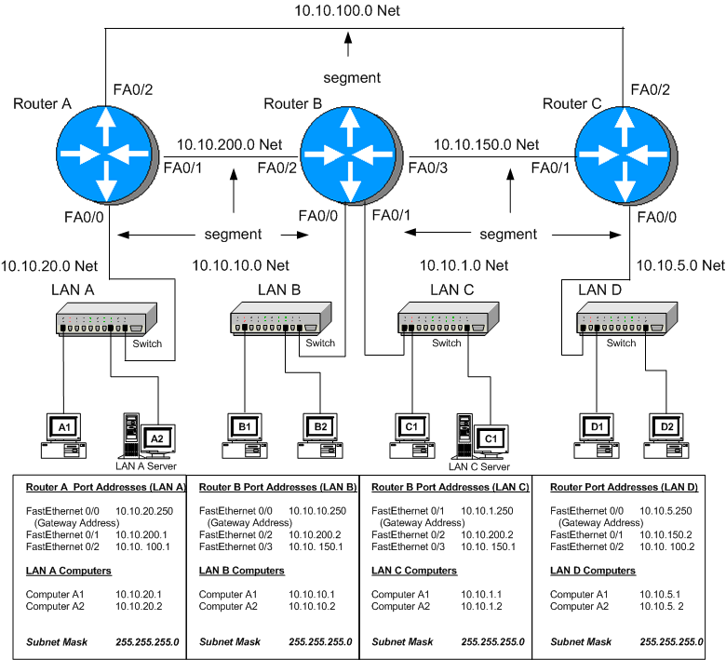

Slide 3
Observations
We need a way to route data packets over the network.
How do the routers communicate or exchange routes.
How do we specify the next hop?

Slide 4
Routing Protocols
Static
Dynamic
  RIP, RIPv2
  IGRP
  OSPF
  EIGRP

Slide 5
Objective
The objective of this section is to demonstrate how data packets are routed in a network using a static routing protocol. The techniques for configuring static routes so that data packets can be forwarded are presented.
A static route is a data traffic route that has been manually entered into either a router’s or computer’s routing table.
The routing table is a list of IP addresses where data traffic can be forwarded.

Slide 6
A PC’s Static Route
A static route is specified in a PC computer in terms of the computer’s default gateway and routers sometimes uses a static route when specifying where the network data traffic is to be forwarded.
Examples of specifying the static route(s) for a computer are first examined.

Slide 7
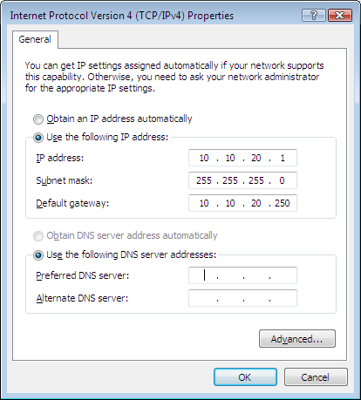
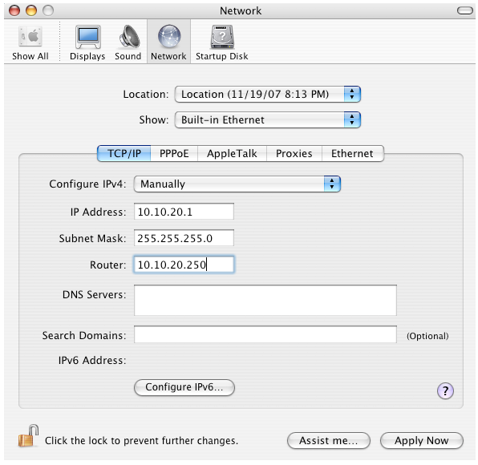
Configuring the Gateway
PC MAC

Slide 8
Examining the PC’s Routing Table
Default Gateway – the most common static route used by the PC
Specified in the TCP/IP set-up for the PC

Slide 9
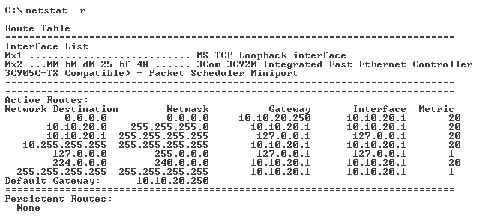
The netstat –r command
also route print
The default route is specified in the routing table by a 0.0.0.0 Network Address entry with a subnet mask of 0.0.0.0. The gateway address of 10.10.20.250 is the IP address of the Ethernet port of the router connected to the LAN. The IP address of 10.10.20.1 for the interface is the IP address for the host computer’s network interface card.

Slide 10
The netstat –r command also route print
The default route is specified in the routing table by a 0.0.0.0 Network Address entry with a subnet mask of 0.0.0.0. The gateway address of 10.10.20.250 is the IP address of the Ethernet port of the router connected to the LAN. The IP address of 10.10.20.1 for the interface is the IP address for the host computer’s network interface card.

Slide 11
The netstat –r command
also route print
The default route is specified in the routing table by a 0.0.0.0 Network Address entry with a subnet mask of 0.0.0.0. The gateway address of 10.10.20.250 is the IP address of the Ethernet port of the router connected to the LAN. The IP address of 10.10.20.1 for the interface is the IP address for the host computer’s network interface card.

Slide 12
The netstat –r command
also route print
The default route is specified in the routing table by a 0.0.0.0 Network Address entry with a subnet mask of 0.0.0.0. The gateway address of 10.10.20.250 is the IP address of the Ethernet port of the router connected to the LAN. The IP address of 10.10.20.1 for the interface is the IP address for the host computer’s network interface card.

Slide 13
The netstat –r command
also route print
The network destination of 10.10.20.0 is returned to the computer’s network interface card at IP address 10.10.20.1. The gateway for the network destination of 10.10.20.1 is 127.0.0.1 which is a loopback to the host computer.

Slide 14
The netstat –r command
also route print
The network destination of 10.10.20.0 is returned to the computer’s network interface card at IP address 10.10.20.1. The gateway for the network destination of 10.10.20.1 is 127.0.0.1 which is a loopback to the host computer.

Slide 15
The netstat –r command
also route print
The network destination of 10.10.20.0 is returned to the computer’s network interface card at IP address 10.10.20.1. The gateway for the network destination of 10.10.20.1 is 127.0.0.1 which is a loopback to the host computer.

Slide 16
The netstat –r command
also route print
The network destination of 10.10.20.0 is returned to the computer’s network interface card at IP address 10.10.20.1. The gateway for the network destination of 10.10.20.1 is 127.0.0.1 which is a loopback to the host computer.

Slide 17
The netstat –r command
also route print
A loopback means that the data is routed directly back to the source. In this case, the source is the computer’s network interface card. The loopback can be used to check that the network interfce is working. Pinging IP address 127.0.0.1 will generate a reply if the interface is working.

Slide 18
What about setting static routes for a router in a small campus network.
First let’s examine how data packets travel from one LAN to another in the three router campus network shown.
Specifically, how is information sent from a host computer in LAN A (10.10.20.0 subnet) to a host computer in LAN B (the 10.10.10.0 subnet)?

Slide 19
The data packets must travel from LAN A to the Router A gateway (E0 interface), from Router A to Router B via the 10.10.200.0 subnet, and then to LAN B via the Router B gateway (E0 interface).
This requires that a physical communications link must be established between the routers and a routing protocol defined for Router’s A and B before data packets can be exchanged.

Slide 20
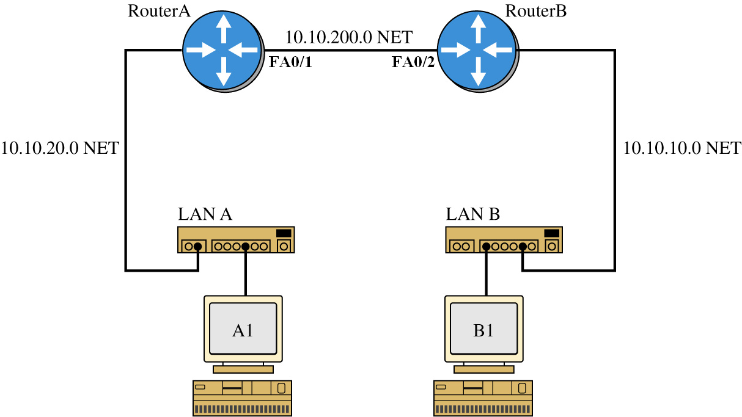
What about setting static routes in the campus network. A simplified network can be used to demonstrate what is required to develop static routes in a multiple router network. For this example, two routers from the campus network are used. The two routers, Router A and Router B connect to LANs A and B as shown. This simplified network will be used to describe how data packets travel from LAN A - Router A - Router B – LAN B and what is required to define the static routes.

Slide 21
The data packets pass through three subnets (indicated by NET) when traveling from LAN A to LAN B. The IP subnets for each network are:
    10.10.20.0 NET LAN A
10.10.200.0 NET Router A connection to Router B
    10.10.10.0 NET LAN B

Slide 22
In this network, there are only two routers with Router A directly connected to Router B. This means that the only route between the routers` is via the 10.10.200.0 NET which is the connection between router A and B. The static route information is entered from the router’s configure terminal prompt (config)# using the ip route command. The command structure for ip route is
Router(config)#ip route destination subnet mask next hop

Slide 23
The destination is the network’s destination IP address (NET), the subnet mask is what has been defined for the subnets, and the next hop is the IP address of the next router in the link. The command for routing the data to the 10.10.10.0 subnet is as follows:
RouterA(config)#ip route 10.10.10.0 255.255.255.0 10.10.200.2

Slide 24
The next hop IP address is the IP address of the Ethernet 2 port on Router B. Now the router knows how to deliver data packets from host computers in the 10.10.20.0 NET (LAN A) to destination computers in the 10.10.10.0 NET (LAN B).
Note: Each static route can use a different subnet mask. This is called variable length subnet masking. For example, one static route could have a subnet mask of 255.255.255.0 and another static route could have a subnet mask of 255.255.255.254.

Slide 25
show ip route
The routing address entry into the routing table can be verified by entering the command show ip route from the router’s (config)#. An example of this is shown:
  RouterA#show ip route
  Codes: C - connected, S - static, I - IGRP, R - RIP, M - mobile, B - BGP
  D - EIGRP, EX - EIGRP external, O - OSPF, IA - OSPF inter area
  N1 - OSPF NSSA external type 1, N2 - OSPF NSSA external type 2
  E1 - OSPF external type 1, E2 - OSPF external type 2, E - EGP
  i - IS-IS, L1 - IS-IS level-1, L2 - IS-IS level-2, * - candidate default
  U - per-user static route, o - ODR
  T - traffic engineered route
  Gateway of last resort is not set
  10.0.0.0/24 is subnetted, 2 subnets
  S 10.10.10.0 [1/0] via 10.10.200.2
  C 10.10.200.0 is directly connected, FastEthernet0/1

Slide 26
What about data traffic flow from the 10.10.10.0 NET (LAN B) to the 10.10.20.0 NET (LAN A)? Once again, the data packets pass through three subnets (indicated by NET) when traveling from LAN B to LAN A. The IP addresses for each subnet are:
10.10.10.0 NET LAN B
10.10.200.0 NET Router B connection to Router A
10.10.20.0 NET LAN A

Slide 27
RouterB(config)#ip route 10.10.20.0 255.255.255.0 10.10.200.1
This information entered into the router is the following:
Destination Subnet Subnet Mask Next Hop
IP Address IP Address
10.10.20.0 255.255.255.0 10.10.200.1

Slide 28
sh ip route
RouterB#sh ip route
Codes: C - connected, S - static, I - IGRP, R - RIP, M - mobile, B - BGP
D - EIGRP, EX - EIGRP external, O - OSPF, IA - OSPF inter area
N1 - OSPF NSSA external type 1, N2 - OSPF NSSA external type 2
E1 - OSPF external type 1, E2 - OSPF external type 2, E - EGP
i - IS-IS, L1 - IS-IS level-1, L2 - IS-IS level-2, * - candidate default
U - per-user static route, o - ODR
T - traffic engineered route
Gateway of last resort is not set
10.0.0.0/24 is subnetted, 2 subnets
S 10.10.20.0 [1/0] via 10.10.200.1
C 10.10.200.0 is directly connected, FastEthernet0/2

Slide 29
What about using static routes in the three-router campus network shown.
Once again, a static route must be entered into Router A’s routing table telling the router how to forward data to the 10.10.10.0 NET.
However, in this example, there are two possible choices for a data packet to travel to the 10.10.10.0 NET from Router A.

Slide 30
Configuring Static Routes
Router(config)#ip route destination subnet mask next hop
Where the destination is the network’s destination IP address (NET)
the subnet mask is what has been defined for the subnets
the next hop is the IP address of the next router in the link
Example: The command for routing the data to the 10.10.10.0 subnet off RouterA is as follows:
RouterA(config)#ip route 10.10.10.0 255.255.255.0 10.10.200.2
RouterA(config)#ip route 10.10.10.0 255.255.255.0 10.10.100.2

Slide 31
Displaying Configured Routes
RouterA#sh ip route
Codes: C - connected, S - static, I - IGRP, R - RIP, M - mobile, B - BGP
D - EIGRP, EX - EIGRP external, O - OSPF, IA - OSPF inter area
N1 - OSPF NSSA external type 1, N2 - OSPF NSSA external type 2
E1 - OSPF external type 1, E2 - OSPF external type 2, E - EGP
i - IS-IS, L1 - IS-IS level-1, L2 - IS-IS level-2, * - candidate default
U - per-user static route, o - ODR
T - traffic engineered route
Gateway of last resort is not set
10.0.0.0/24 is subnetted, 2 subnets
S 10.10.10.0 [1/0] via 10.10.200.2
S 10.10.10.0 [1/0] via 10.10.100.2
C 10.10.200.0 is directly connected, FastEthernet0/0
C 10.10.100.0 is directly connected, FastEthernet0/1

Slide 32
Displaying the running-confugration
RouterA#sh run
!
!
ip route 10.10.5.0 255.255.255.0 10.10.200.2
ip route 10.10.5.0 255.255.255.0 10.10.100.2
!
!

Slide 33
Router Command Summary
Table 9-1 Summary of commands used to configured the static routing protocol
Command Use
ip route used to specify the destination IP address, the subnet mask, and the next hop IP address
show ip route shows the IP routes listed in the routing table.
show ip route static shows only the static IP routes listed in the routing table
show running-config shows the router’s running-configuration
show startup-config shows the routers saved configuration in NVRAM
wr m copies the current router changes to memory (NVRAM
copy run start copies the current router changes to memory (NVRAM)

Slide 34
Static Routes - Summary
When static routes are used, the network administrator in essence, becomes the routing protocol. In other words, the network administrator is making all of the decisions regarding data traffic routing.

Slide 35
Static Route Issues
This requires that the network administrator must know all network data routes, setup up the routes to each subnet and be constantly aware of any route changes.

Slide 36
Gateway of last resort
One of the most important applications for using a static route is for configuring the Gateway of last resort on a router.
The Gateway of last resort is the IP address of the router in your network where data packets with unknown routes should be forwarded.
The purpose of this is to configure a route for data packets that do not have a destination route configured in the routing table. In this case, a default route can be configure that instructs the router to forward the data packet(s) with an unknown route to another router. The command for doing this is
ip route 0.0.0.0 0.0.0.0 <next hop address>

Slide 37
Network-Challenge
Open the Chapter 9 – Static Challenge and verify you can configure static routes

Slide 38
Chapter 9-2 Key Terms
Static Route
netstat-r
route print
Loopback
Variable Length Subnet Masking
show ip route (sh ip route)
S
C

Slide 39
Chapter 9-2 Key Terms
show running-configuration
show startup-configuration (sh start)
copy run start
write memory (wr m)

